Slide 1
From Output to Outcome
- Agile2018 Report -
Hiroyuki Ito

Slide 2
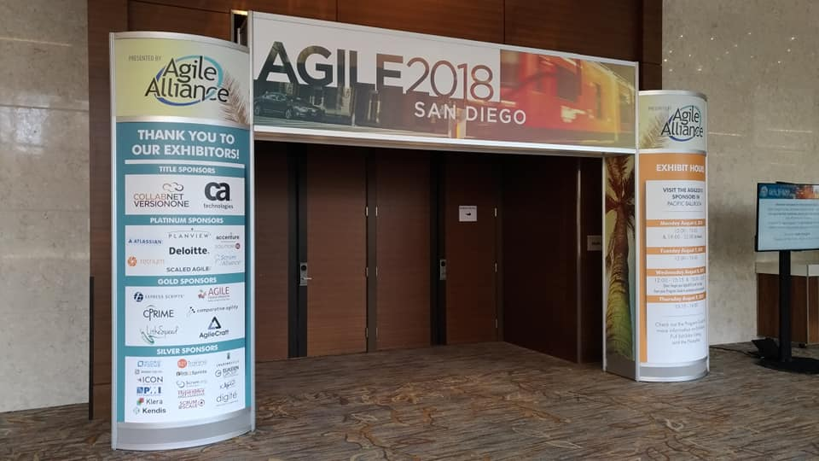
Open Your Gate

Slide 3




In San Diego, CA, USA

Slide 4
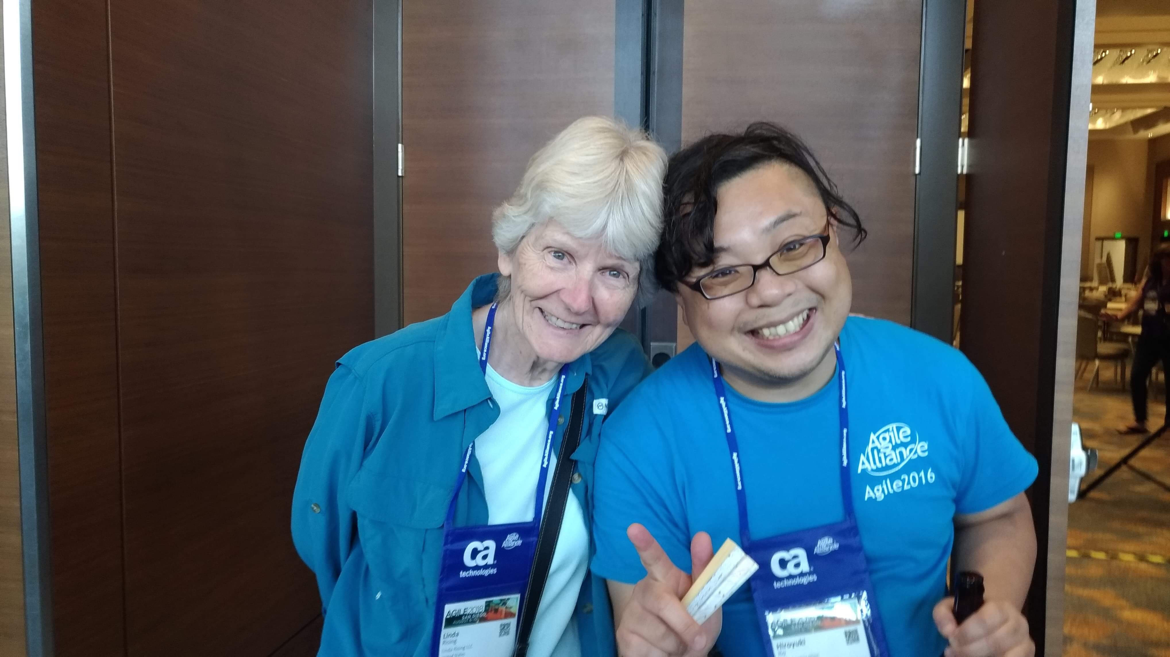
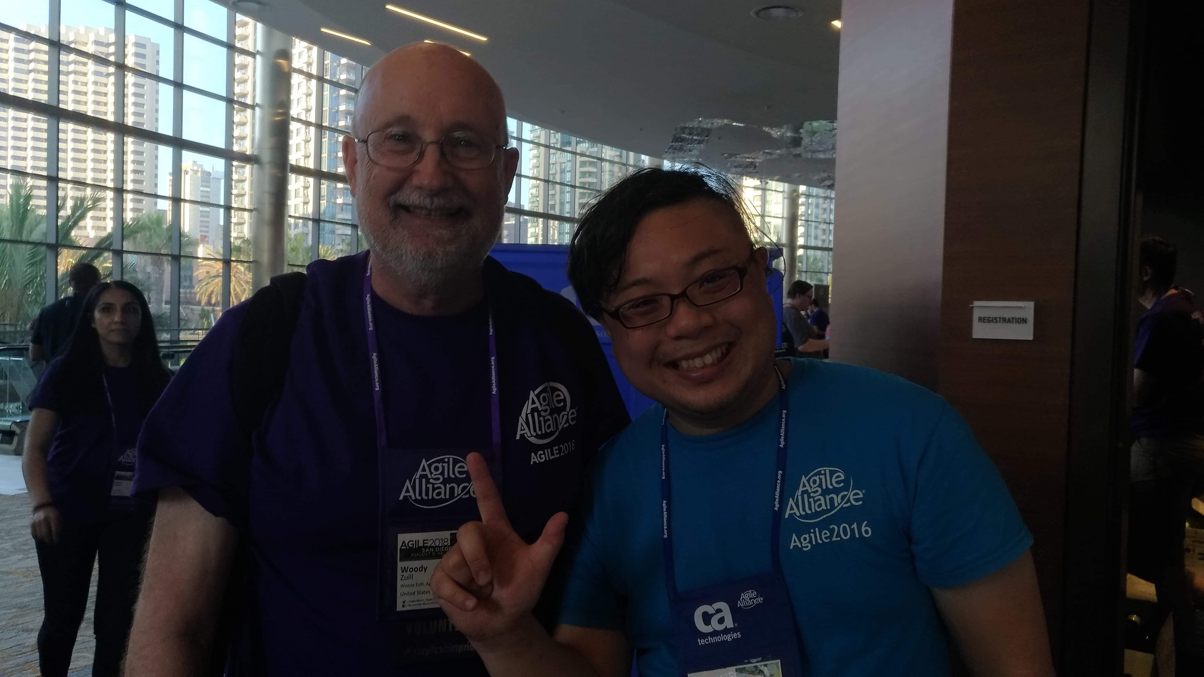
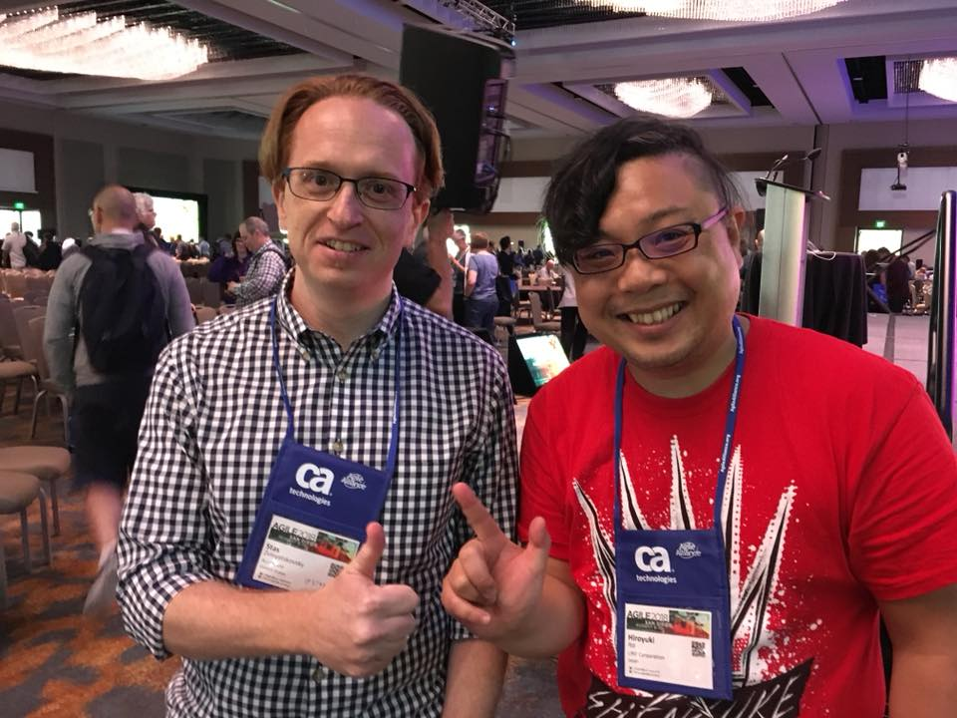
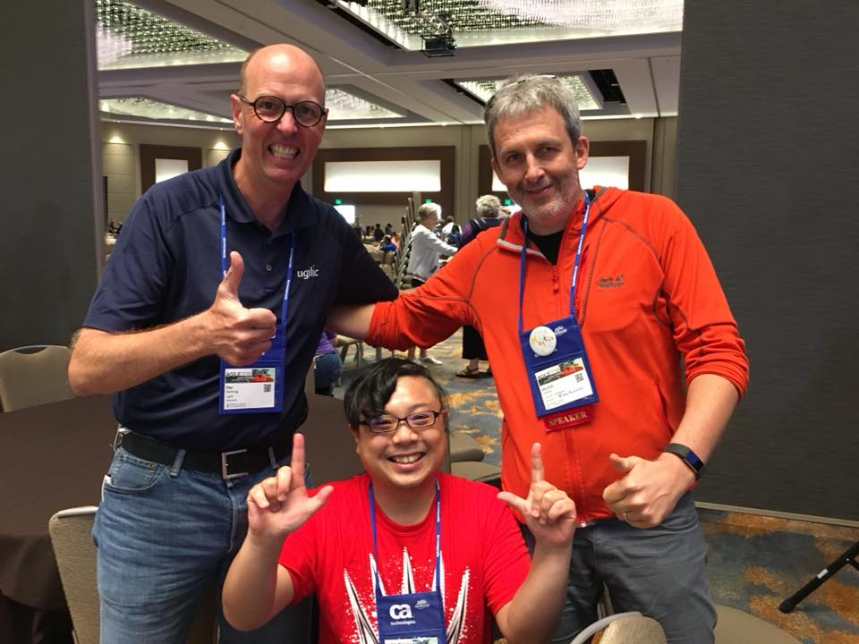
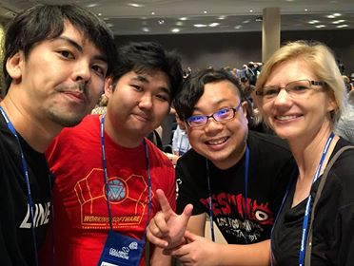
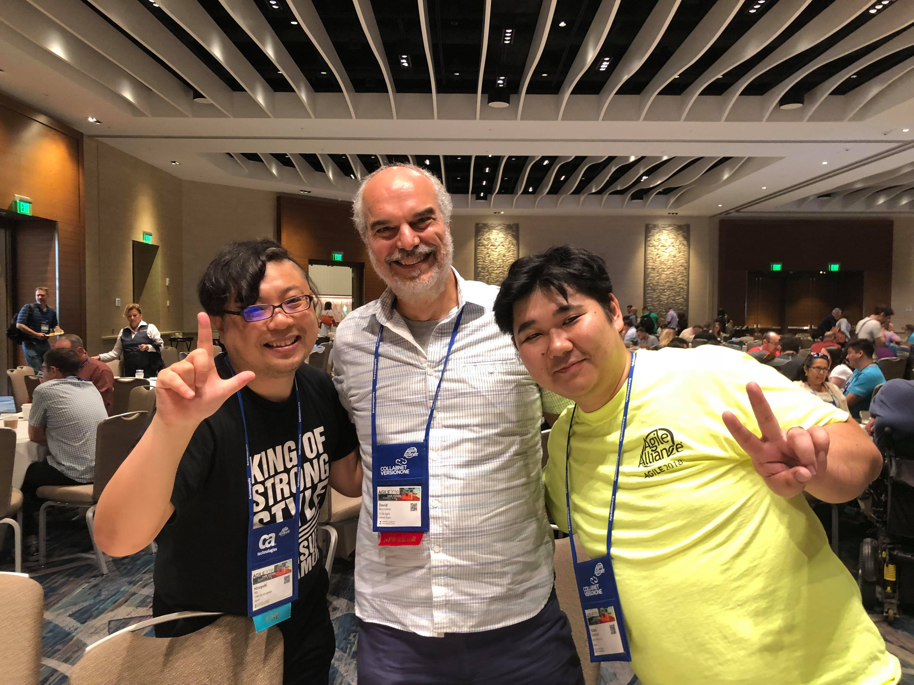
With Global Practitioners!

Slide 5
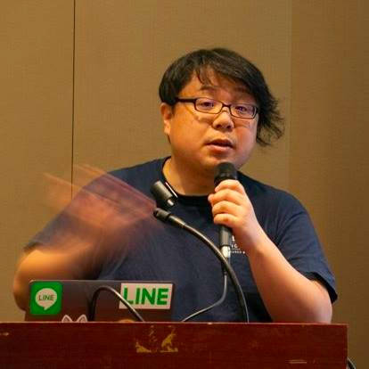


Hiroyuki Ito (The HIRO)
@hageyahhoo
The 1st SET at LINE Corp.
Keynote speaker of DevOps Summit 2016 (TW)
Speaker of Agile2014

Slide 6
$ history
6 times attendee from Japan!
[Reports]
Agile2017 (JP)
Agile2016 (JP)
Agile2014 (EN)
Agile2013 (JP)
Agile2012 (JP)

Slide 7
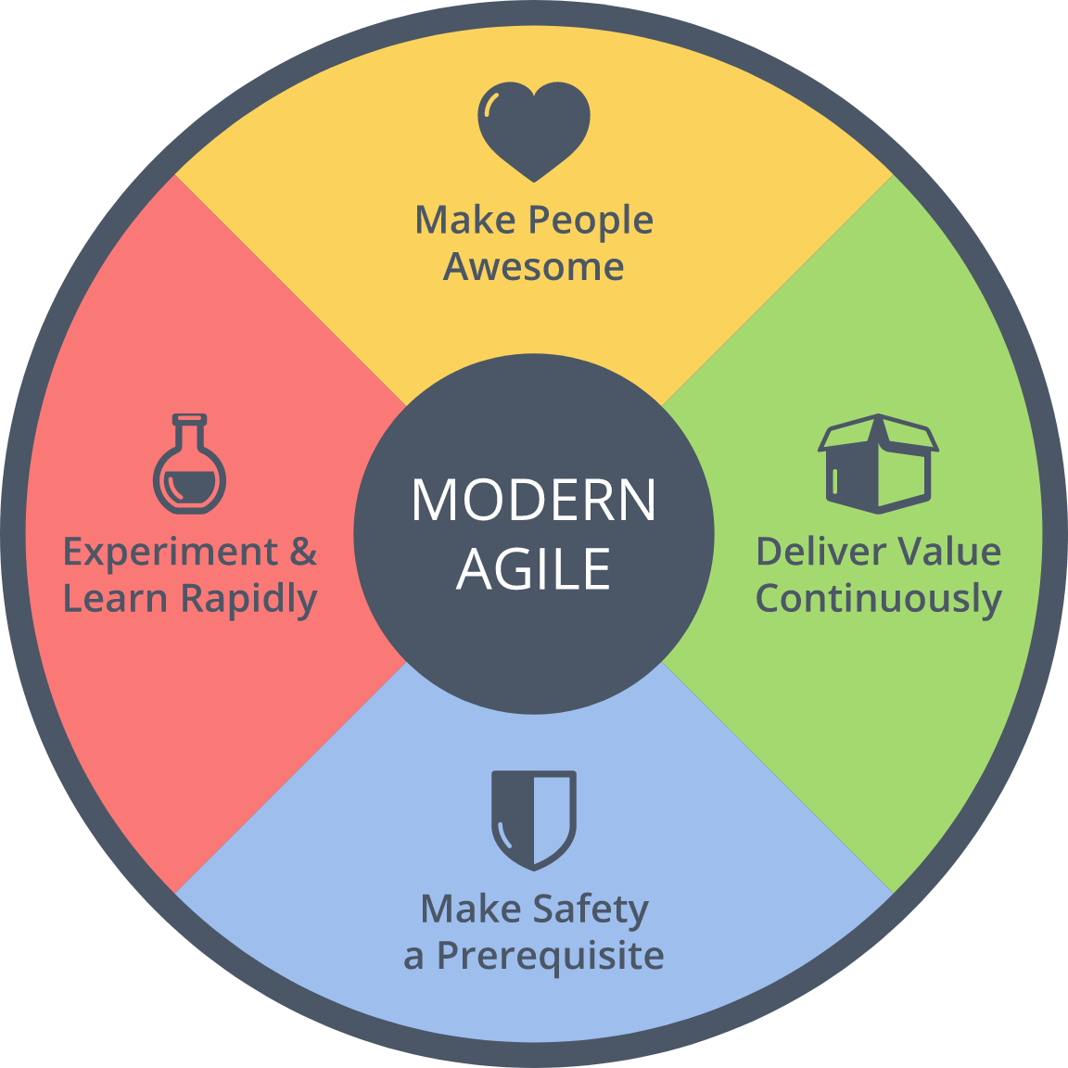
$ history
Achievements
2016 : Brought back
2014 : Speaker
Brought back Metrics
2013 : Speech at OpenJam

Slide 8

Disclaimer
This is a flash report
from SET perspective
of LINE Corp. ☺

Slide 9
Agenda
1. Summary of Agile2018
2. Three Big Trends
3. Focus More on Outcome
4. Misc.
5. Conclusion

Slide 10
1. Summary of Agile2018
2. Three Big Trends
3. Focus More on Outcome
4. Misc.
5. Conclusion

Slide 11

What is Agile2018?
https://www.agilealliance.org/agile2018/
Annual global conference of Agile in USA
The biggest one of Agile
Held by Agile Alliance

Slide 12
Basic Information
Duration | Aug. 6th – 10th (5 days)
# of Sessions | 279 (+5 YoY)
# of Categories | 21 (±0 YOY)
# of Parallel On-going Sessions | 20 (+1 YoY)
# of Attendees | 2,500
Type of Sessions | Talk/Workshop
Level of Sessions | Learning/Practicing/ Advancing

Slide 13
Categories (2018)
Category | # | Category | #
Agile Companies | 16 | Keynotes | 3
Agile Data Metrics and Forecasting | 6 | Leadership | 21
Agile Foundations | 7 | Learning | 19
Agile Midway | 7 | Project Program & Portfolio Management | 18
Coaching & Mentoring | 21 | Testing & Quality | 12
Collaboration Culture & Teams | 24 | User Experience | 12
Customers & Products | 15 | Experience Reports | 24
Dev Practices and Craft | 17 | The Future of Agile Software Development (IEEE Software) | 8
DevOps | 12 | Audacious Salon | 14
Enterprise Agile | 20 | Stalwarts | 10

Slide 14
Categories (2018)
Category | # | Category | #
Agile Companies | 16 | Keynotes | 3
Agile Data Metrics and Forecasting | 6 | Leadership | 21
Agile Foundations | 7 | Learning | 19
Agile Midway | 7 | Project Program & Portfolio Management | 18
Coaching & Mentoring | 21 | Testing & Quality | 12
Collaboration Culture & Teams | 24 | User Experience | 12
Customers & Products | 15 | Experience Reports | 24
Dev Practices and Craft | 17 | The Future of Agile Software Development (IEEE Software) | 8
DevOps | 12 | Audacious Salon | 14
Enterprise Agile | 20 | Stalwarts | 10
Promoted as one category!

Slide 15
Categories (2018)
Category | # | Category | #
Agile Companies | 16 | Keynotes | 3
Agile Data Metrics and Forecasting | 6 | Leadership | 21
Agile Foundations | 7 | Learning | 19
Agile Midway | 7 | Project Program & Portfolio Management | 18
Coaching & Mentoring | 21 | Testing & Quality | 12
Collaboration Culture & Teams | 24 | User Experience | 12
Customers & Products | 15 | Experience Reports | 24
Dev Practices and Craft | 17 | The Future of Agile Software Development (IEEE Software) | 8
DevOps | 12 | Audacious Salon | 14
Enterprise Agile | 20 | Stalwarts | 10
Promoted as one category!
Decreasing. Maybe moved to deliver:Agile 2018

Slide 16
[FYI] Categories (2017)
Category | # | Category | #
Agile Alliance Lounge | 16 | Leadership | 21
Agile Companies | 13 | Learning | 17
Agile Foundations | 7 | Project Program & Portfolio Management | 21
Coaching & Mentoring | 17 | Testing & Quality | 12
Collaboration Culture & Teams | 24 | User Experience | 10
Customers & Products | 15 | Experience Reports | 24
Development Practices & Craftsmanship | 24 | The Future of Agile Software Development (IEEE Software) | 8
DevOps | 16 | Audacious Salon | 14
Enterprise Agile | 25 | Open Jam | 6
Keynotes | 3 | Stalwarts | 11

Slide 17
1. Summary of Agile2018
2. Three Big Trends
3. Focus More on Outcome
4. Misc.
5. Conclusion

Slide 18
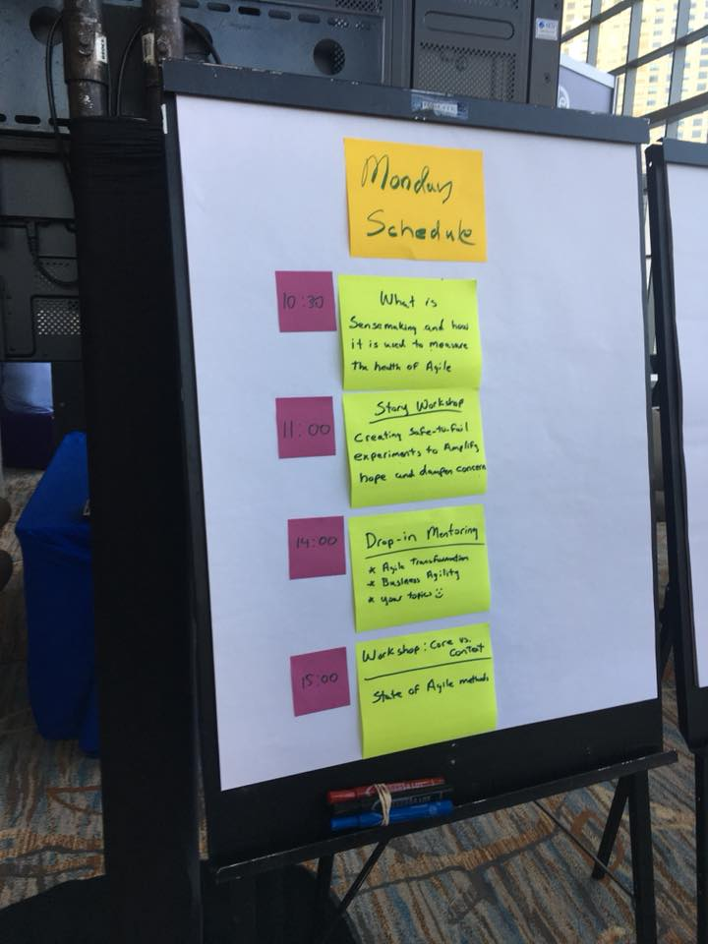
3 Big Trends of Agile2018
Scaling Agile
Business Agility
Technologies for Trial & Errors

Slide 19
1) Scaling Agile
There are 2 meanings:
Scaling development teams
Collaboration with remote teams
Scaling framework (LeSS/SAFe/Nexus)
Expanding a team to business
Including business persons to Agile product development teams

Slide 20
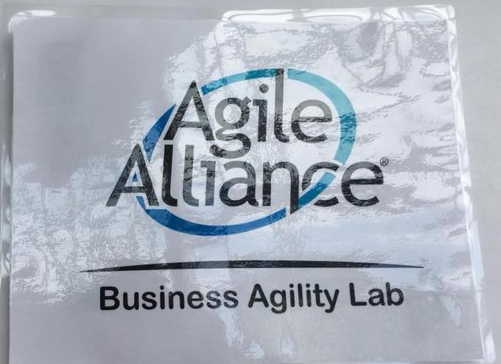
2) Business Agility
For example:
Beyond IT
Utilize Agile in corporate level
Metrics as a tool for it

Slide 21
2) Business Agility
Not mature yet:
Has not reached to pragmatic ideas and practices
Focusing more on outcome is a good attitude to overcome the limitation of Agile Software Development

Slide 22
3) Tech for Trial & Errors
For example:
DevOps
Database DevOps
BizDevOps (+ business)
DevSecOps (+ security)
Continuous Delivery/Deployment

Slide 23
3) Tech for Trial & Errors
We can utilize them for
making development easier
delivering values to markets more quickly
giving impact to business
increasing outcome

Slide 24

Summary
Focusing more on outcome
is the biggest trend
of Agile2018

Slide 25
1. Summary of Agile2018
2. Three Big Trends
3. Focus More on Outcome
4. Misc.
5. Conclusion

Slide 26
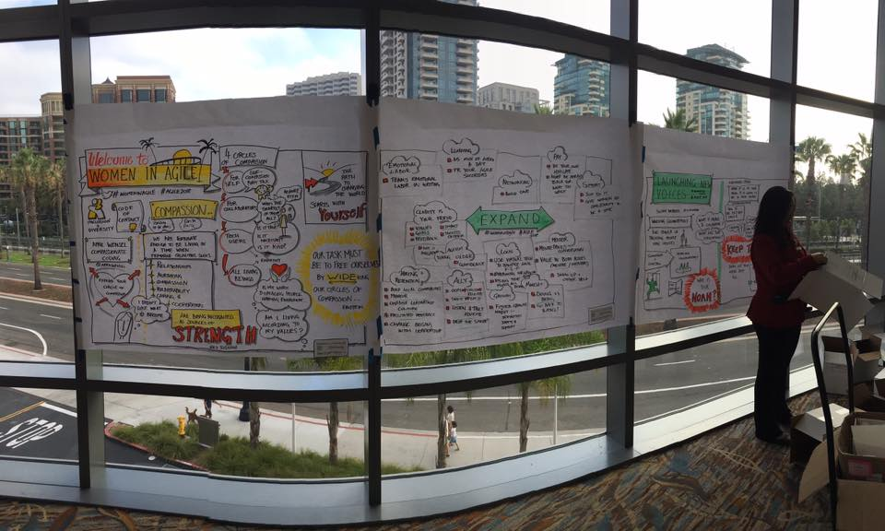
3 Approaches
Technical Approach
Process Approach
Tools

Slide 27
1) Technical Approach

Slide 28
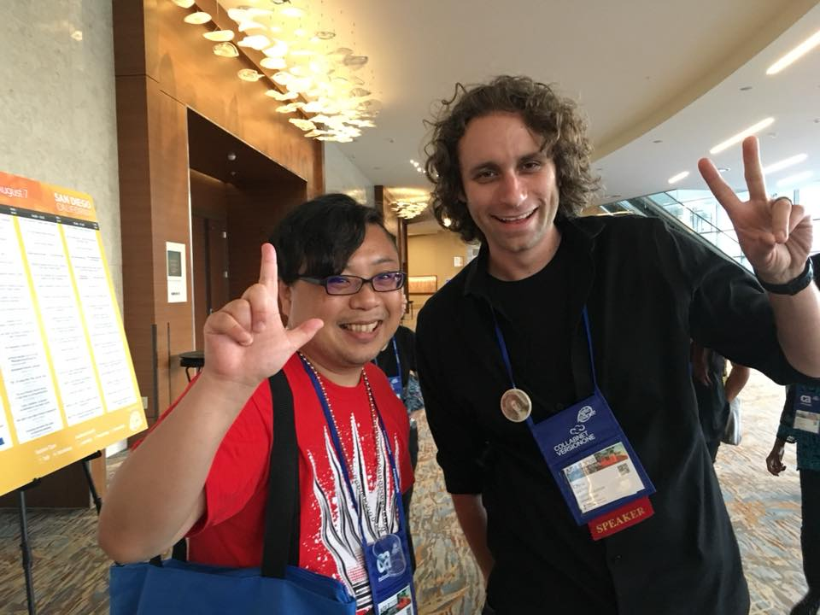
Continuous Delivery
By Chris Lucian
Paper
Scale teams (mobs)
Make experiments easier
CD for DB
DB schema
UT for Stored Procedure
Impact to outcome

Slide 29
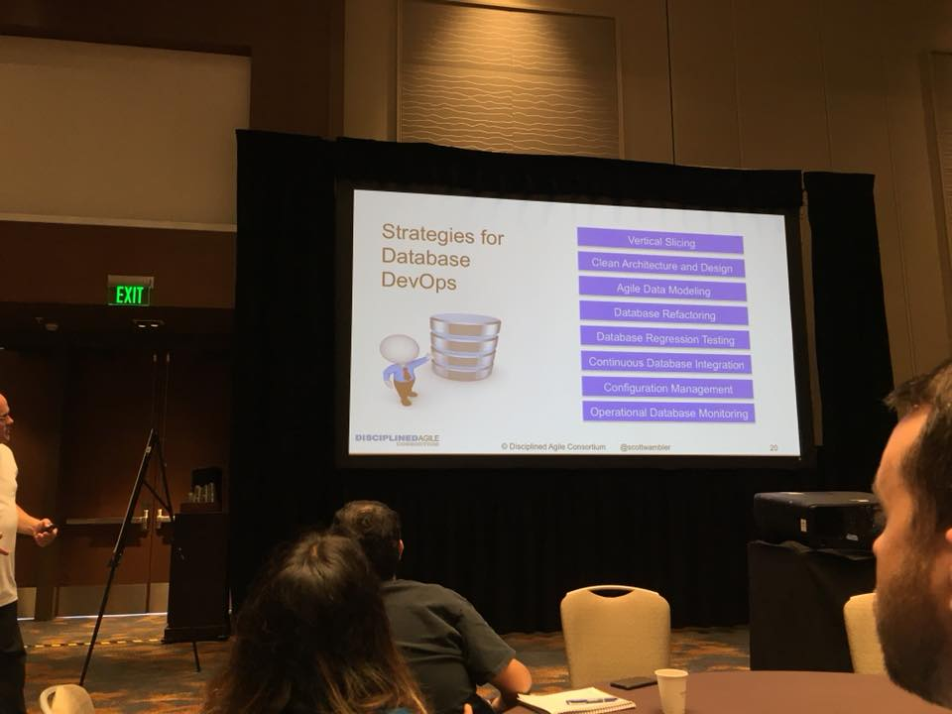
Database DevOps
By Scott Ambler
Session Info
Strategies:
Vertical Slicing
Clean Architecture/Design
Agile Data Modeling
DB Refactoring
DB Regression Testing
Continuous Database Integration
Config Management
Operational DB Monitoring

Slide 30
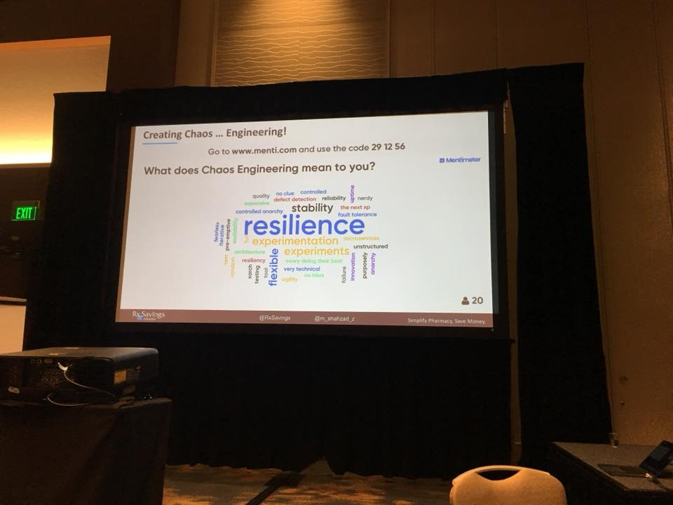
Chaos Engineering
By Shahzad Zafar
Session Info
Start from hypothesis
Prioritize actions based on risks
Real experiments
e.g.) Failure of LB
Scaling beyond a team

Slide 31
2) Process Approach

Slide 32

Metrics (Agile Data)
By Troy Magennis
Data is:
People problem
Making people safer & happier
For predictability
For forecasting

Slide 33

Metrics (Agile Data)
Data shows stories behind it! -> Leads us to right actions
https://www.youtube.com/watch?v=jbkSRLYSojo

Slide 34
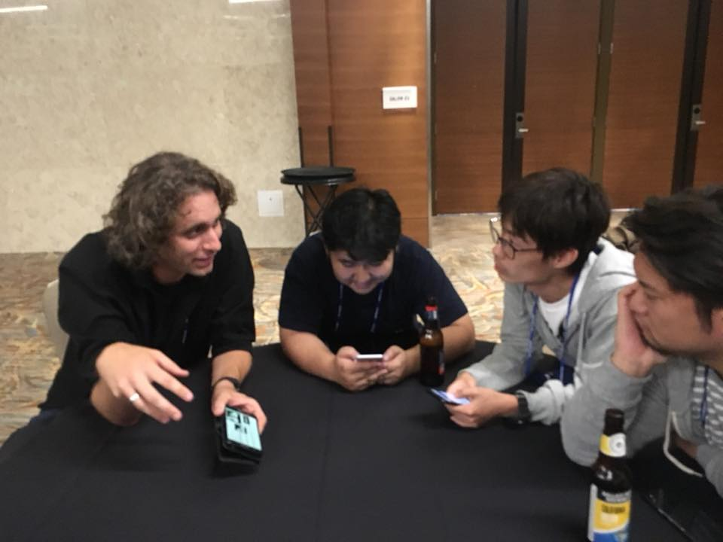
Mob Programming
Communication:
Mob can expand communication bandwidth
No estimation
No daily meeting
Can adjust key-binding
Should not change a mob to reduce communication costs

Slide 35
Mob Programming
Built autonomy:
Do small
Get feedback
Iterate quickly
e.g.) Reference

Slide 36
Learning to Experiment
By Chris Lucian
Paper
Refining the process
continuously
without emergency!
Not estimating
Continuous delivery
Learning sessions
Continuous experimentation
Frequent retrospectives

Slide 37
3) Tools

Slide 38
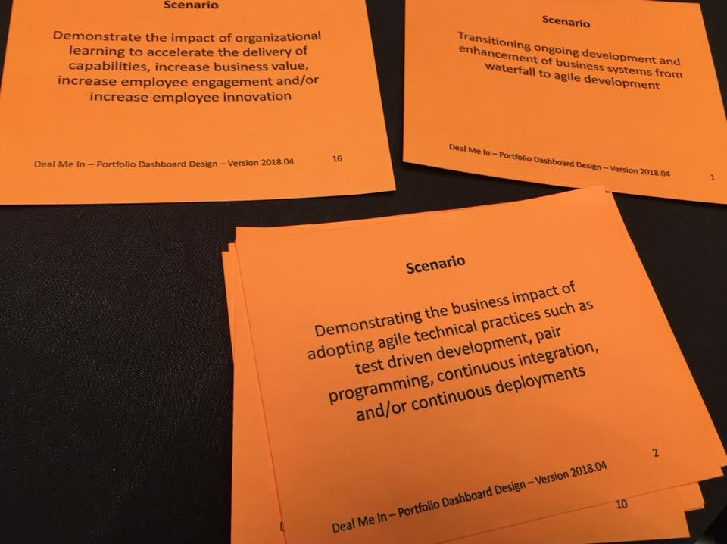
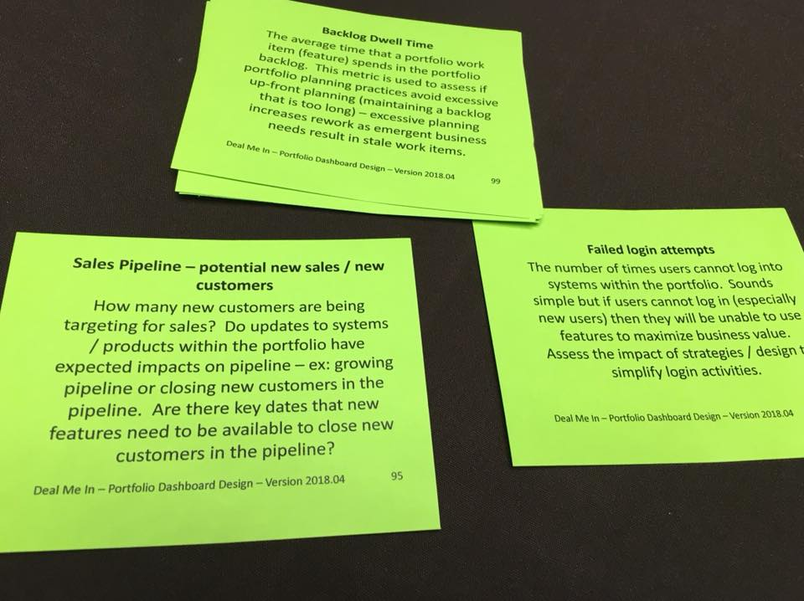
Portfolio Dashboard Poker
Can start/facilitate communication
with prepared/often-used ideas
Scenarios
Metrics

Slide 39
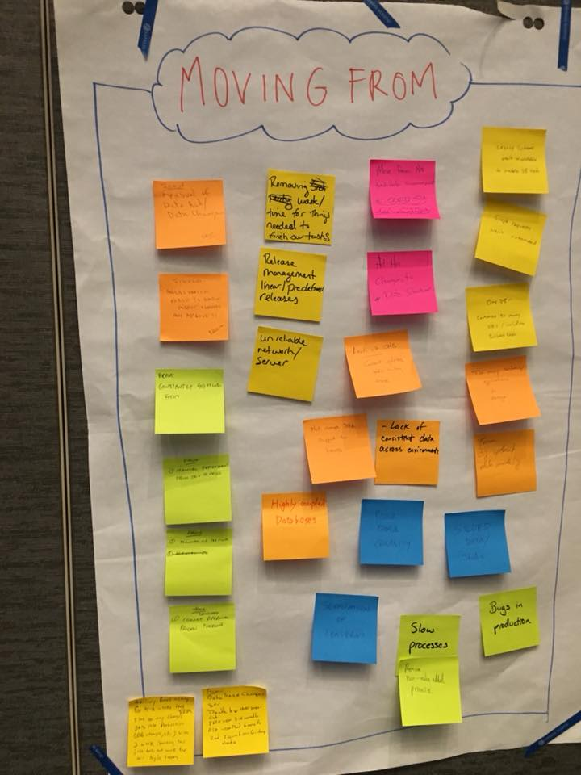
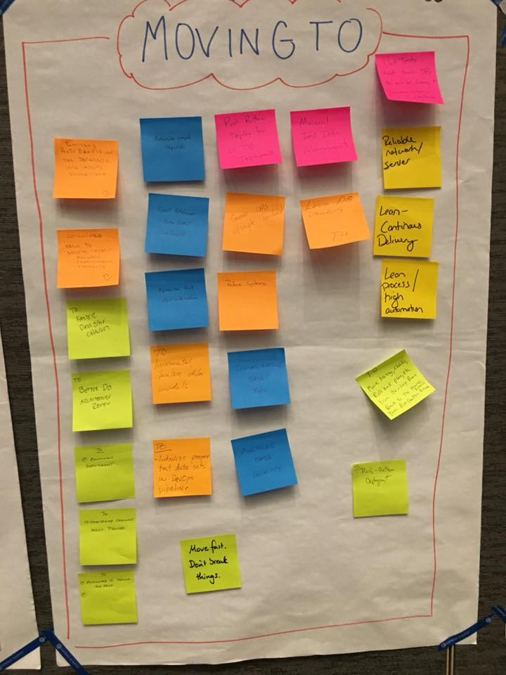
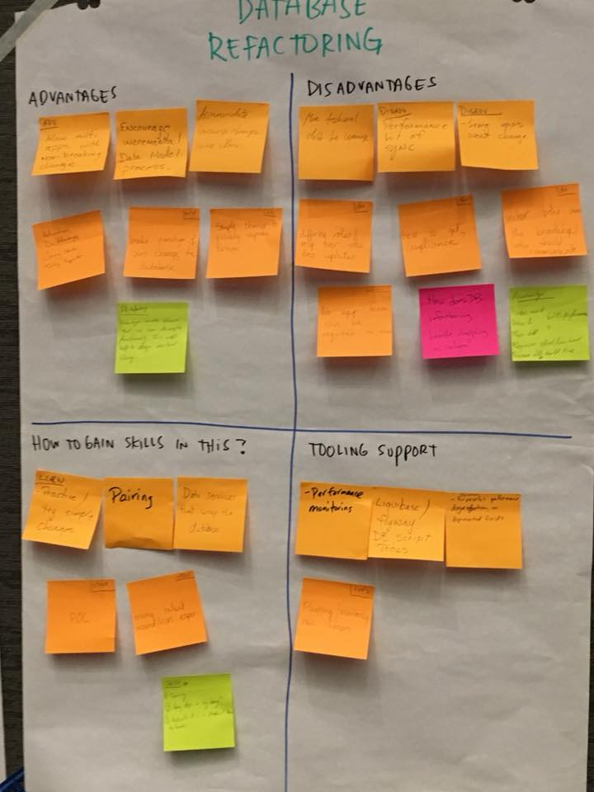
Wisdom of Crowds
Can gather ideas widely
from different contexts
Problems
Solutions
Analysis

Slide 40

Summary
Business impact
based on “Psychological Safety”
with 3 bases
Tech
Process
Tools

Slide 41
1. Summary of Agile2018
2. Three Big Trends
3. Focus More on Outcome
4. Misc.
5. Conclusion

Slide 42
Testing & Quality
They are common topics
Code review by Testers
Facilitation by Testers
BDD
Developer Testing
Testers should overcome
current role/silo!

Slide 43
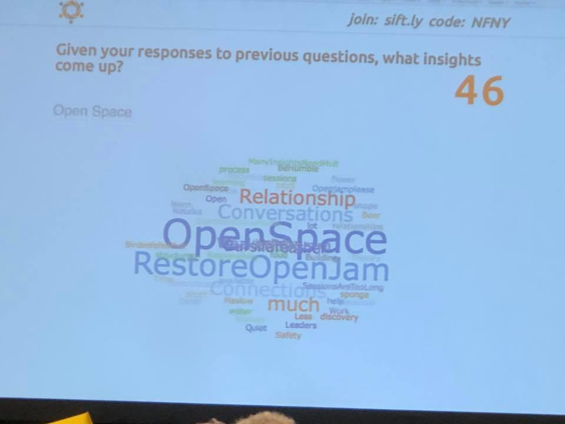
No OpenJam ☹
So many attendees
showed dissatisfaction
OpenJam is a chance to make presentations freely!
It had held until 2017
I prepared for a presentation but disappeared this year ☹
Please resume it!

Slide 44
Not Only Sessions
We can reach to practitioners
whenever we can!

Slide 45
1. Summary of Agile2018
2. Three Big Trends
3. Focus More on Outcome
4. Misc.
5. Conclusion

Slide 46
Agile is trying to reach to business

Slide 47
New technology/practices/tool
are increasing for Business Agility

Slide 48
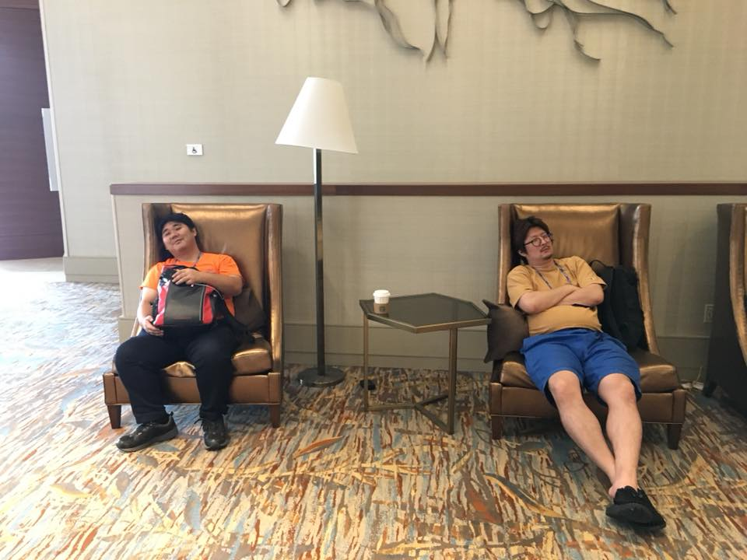
But...immature yet

Slide 49
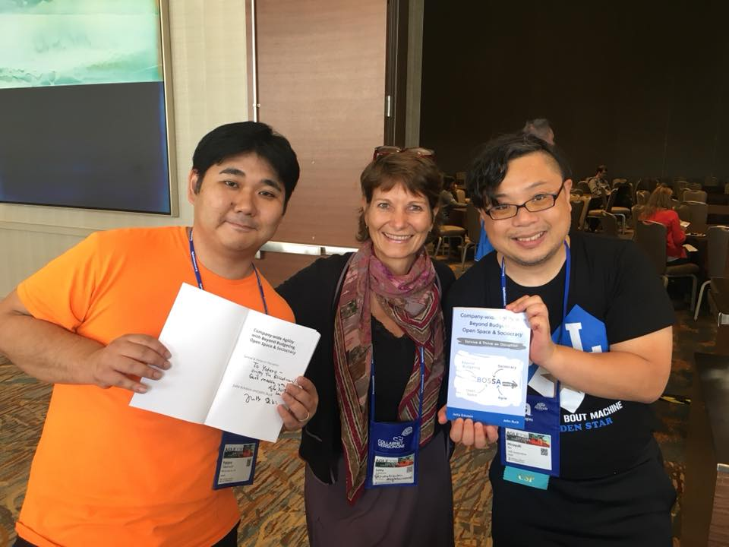
Let’s find our way
to contribute to our business
with Agile!

Slide 50
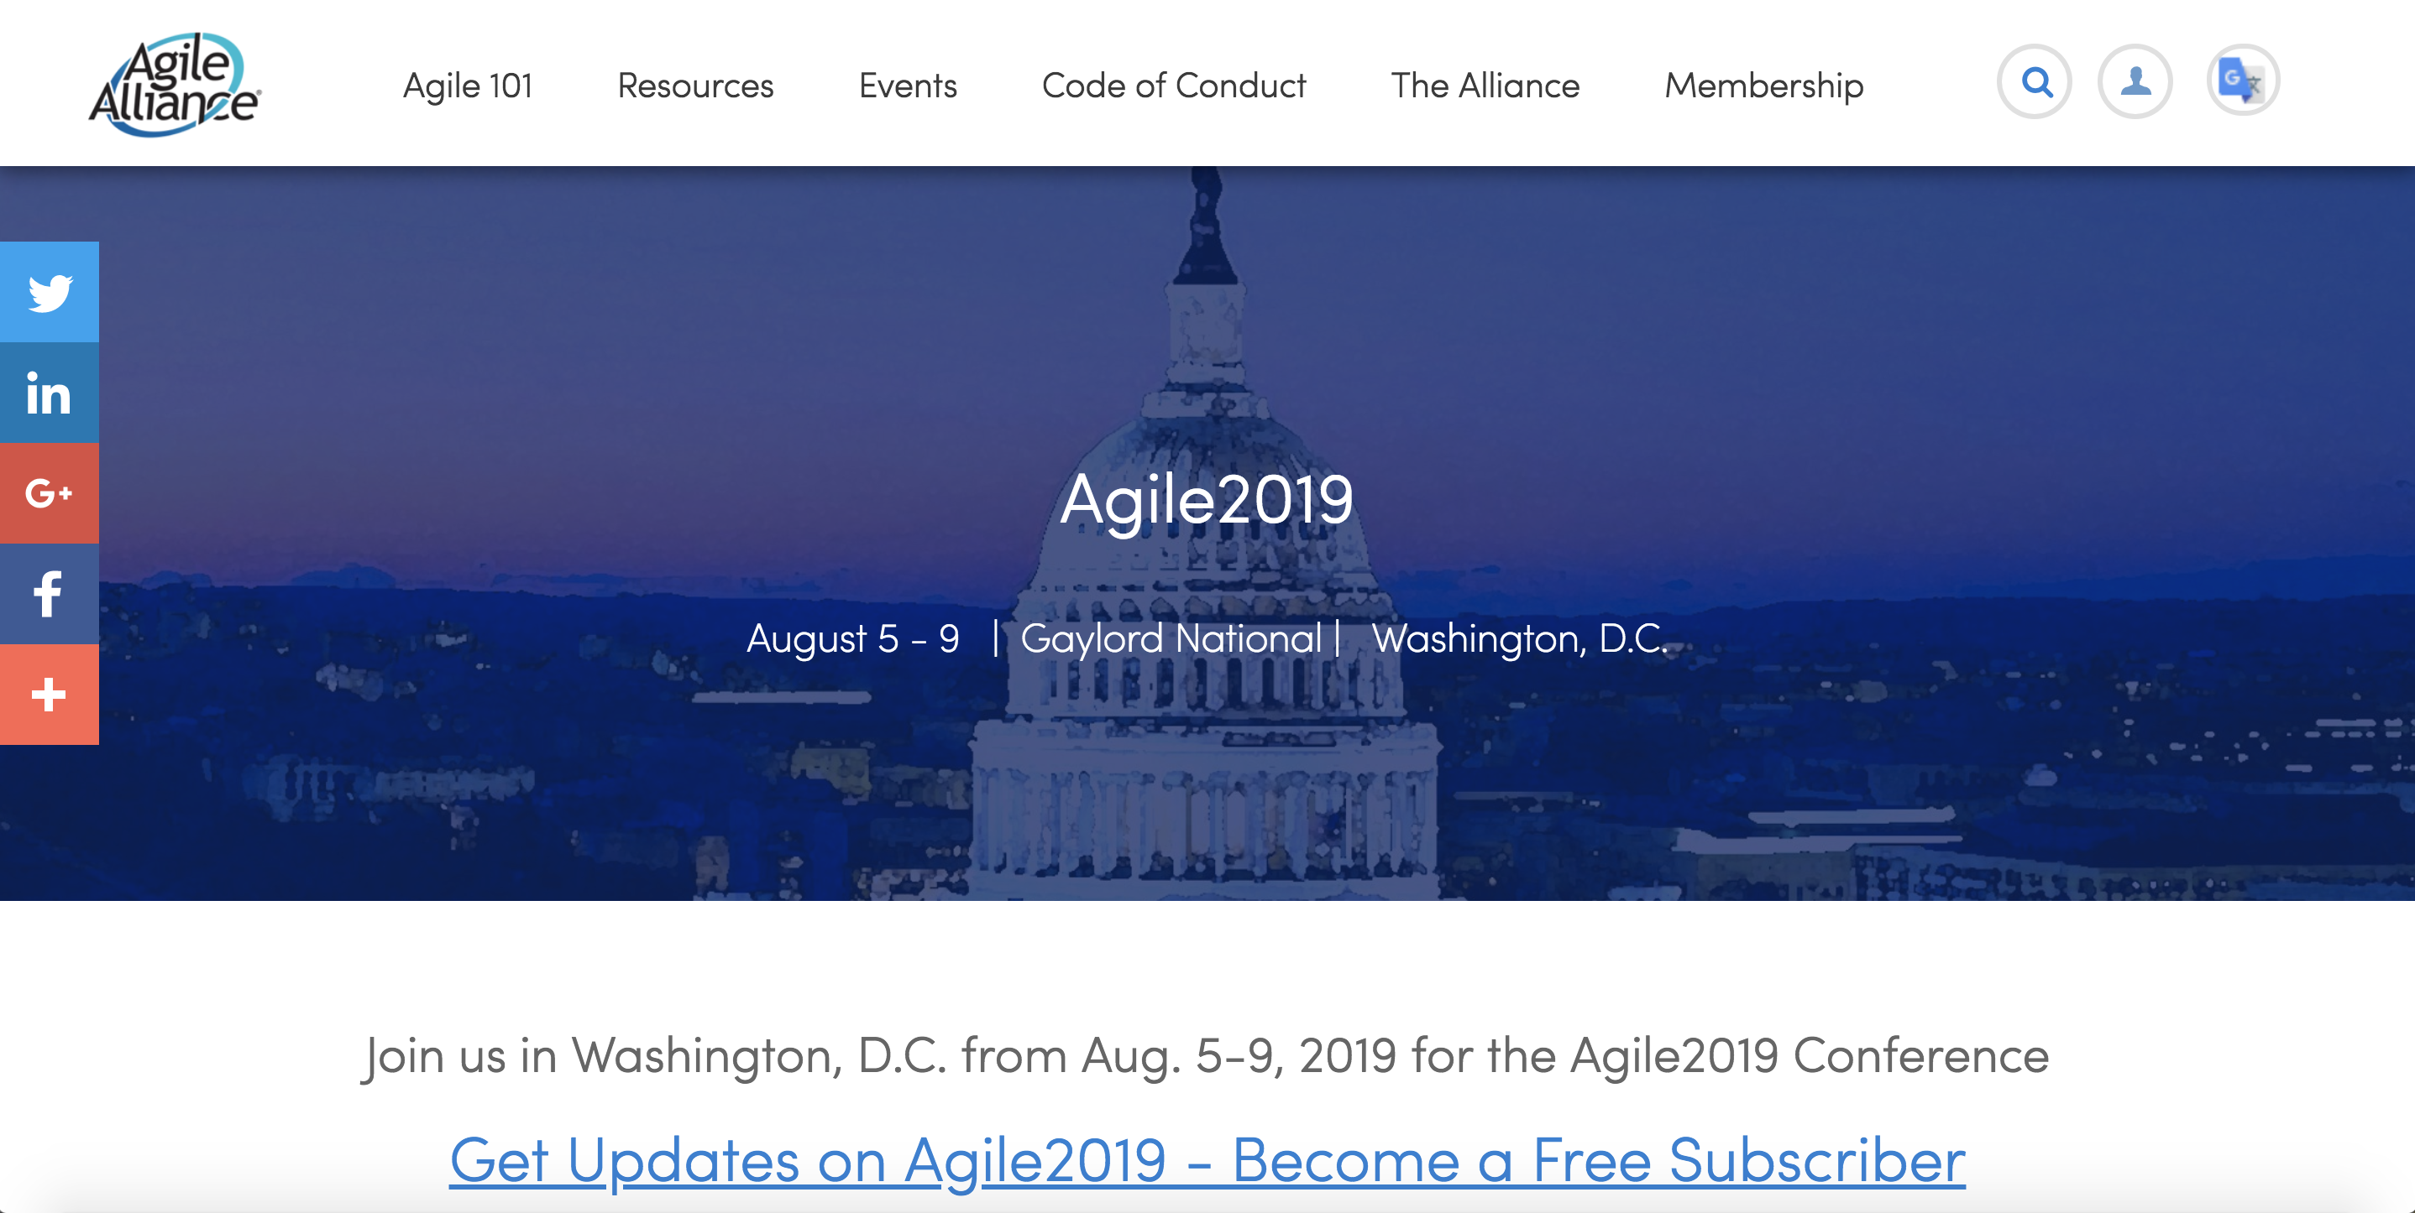
And...Show Our Ideas!
https://www.agilealliance.org/agile2019/

